Slide 1
UA Day 2024 Universal Acceptance Readiness of the University of the West Indies Global Campus Admissions Portal
by Reiza Haniff and Anil Ramnanan (UWI Global Campus)

Slide 2
Who are we?
The University of the West Indies (UWI),
A public university system established to serve the higher education needs of the residents of 18 English-speaking countries and territories in the Caribbean
Each country is either a member of the Commonwealth of Nations or a British Overseas Territory.

Slide 3
The University of the West Indies Open Campus (UWIOC) (2007)
The University of the West Indies Open Campus (UWIOC) was approved in 2007 to improve services to the non-campus territories.
The University of the West Indies Open Campus (UWIOC) is a public and distance learning focused, research university.
It is one of 5 general autonomous units of the University of the West Indies system.

Slide 4
UWI Open Campus Rebranding

Slide 5
The University of the West Indies Global Campus (UWIGC)
The UWI Global Campus, (formerly The UWI Open Campus) is a strategic initiative by The University of the West Indies, established to expand access to high-quality higher education across the Caribbean Region.
The emergence of the Global Campus on August 1, 2023, formally initiates The UWI's transformation to a next-generation digital institution delivering its online programmes and courses to global markets.

Slide 6
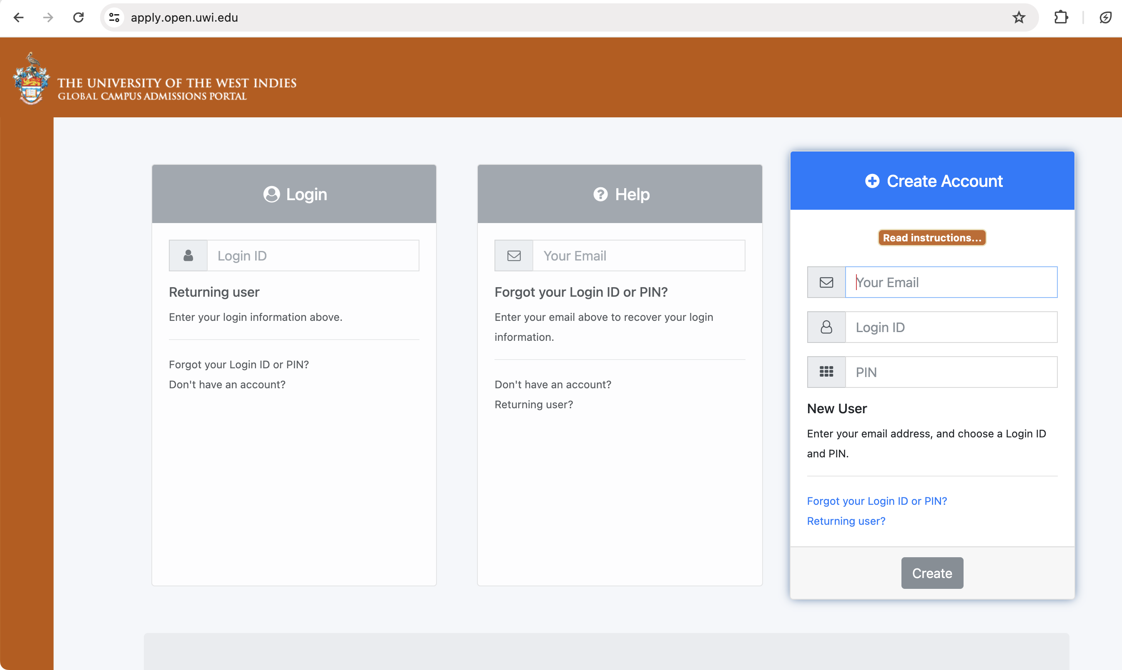
Campus Admissions Portal (Account Creation)
Applications can sign up for an account with in the portal to submit applications for programmmes

Slide 7
Campus Admissions Portal
User enters an email address
1
Client Side validation of address
2
Server Side validation of email address
3
Database stores ASCII email address
4
Mail Transfer Application uses email address to send email.
5

Slide 8
Testing UA Readiness
Support for internationalised domain names (IDN) and email address internationalisation (EAI)
Support for email that contains international characters which do not exist in the ASCII character set,
Traditional email addresses
International email
Abc@example.com
Abc.123@example.com
अजय@डाटा.भारत (Hindi)
احمر@آرنت.شبكة (Arabic)

Slide 9
Campus Admissions Portal: Testing

Slide 10
Campus Admissions Portal: Issues
Client side validation fails
Server side validation fails
Database cannot store email address
MTA cannot use IDN email address to send mail

Slide 11
Campus Admissions Portal: Fixes
Client side validation updated
to new version of validator.js
Server side validation updated
to use PHP's intl extension, specifically the idn_to_utf8() and idn_to_ascii() functions

Slide 12
Campus Admissions Portal: Fixes
Database updated to to store email address
(using utf8mb4 for Original and ASCII encoded).
Patched PHPMailer used to send mail
using modifications made by Arnt Gulbrandsen (UA Technology Senior Manager, ICANN)

Slide 13
Campus Admissions Portal: UA Fixes

Slide 14
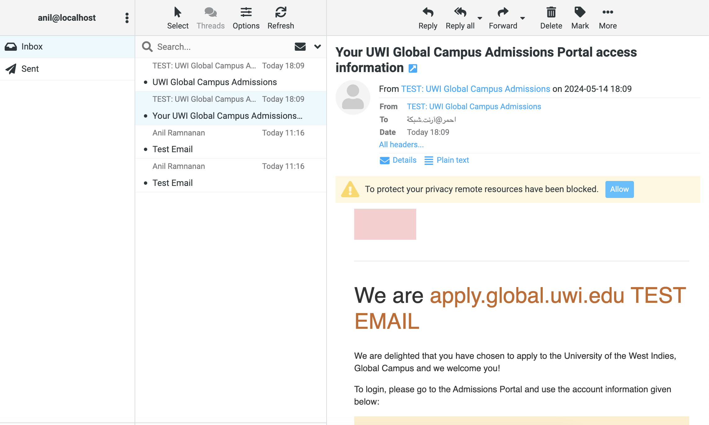

Slide 15
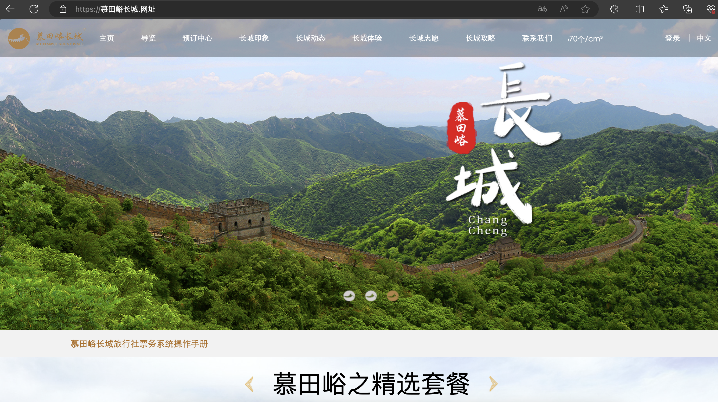

Slide 16
Benefits of UA Readiness
Enhanced Global Accessibility:
Increased Market Reach
Improved User Experience
Compliance and Standards Adherence:

Slide 17
Thank You!
Development done by Reiza Haniff and Anil Ramnanan (UWI Global Campus)
Presentation by Anil Ramnanan (UWI Global Campus)
https://global.uwi.edu/

